Slide 1
Data Driven Predictions of Student Depression
DATS 6101 Final Project
Meghan Casey, Raye Hazel Oji, Siddardha Priyatham Reddy (Siddu) Yaraguti, Venkata Siva Kumar Reddy Madire (SIVA), Siddhant Saxena
TEAM DATA PANDAS

Slide 2
Our Dataset & Research Question
AGE
FAMILY HISTORY
GENDER
The objective of our research project is to investigate How accurately can we predict students at risk of depression?
Based on information about students mental health and related factors publicly available on Kaggle.
27,902 observations with 18 features.
2 potential target variables, depression and experience of suicidal thoughts.
DEPRESSION
DIET
STRESS
SLEEP

Slide 3
Data Processing & Cleaning
Remove Unnecessary Columns
Check for Duplicates
Check for Missing Values
Convert Variable Types
ID and profession aren’t relevant to our analysis.
Only one duplicate! We removed it.
There were a few missing values for financial stress. We will keep that in mind when analyze that variable.
Convert academic/work pressure, study/job satisfaction, sleep duration, and dietary habits to ordinal variables before analysis.

Slide 4
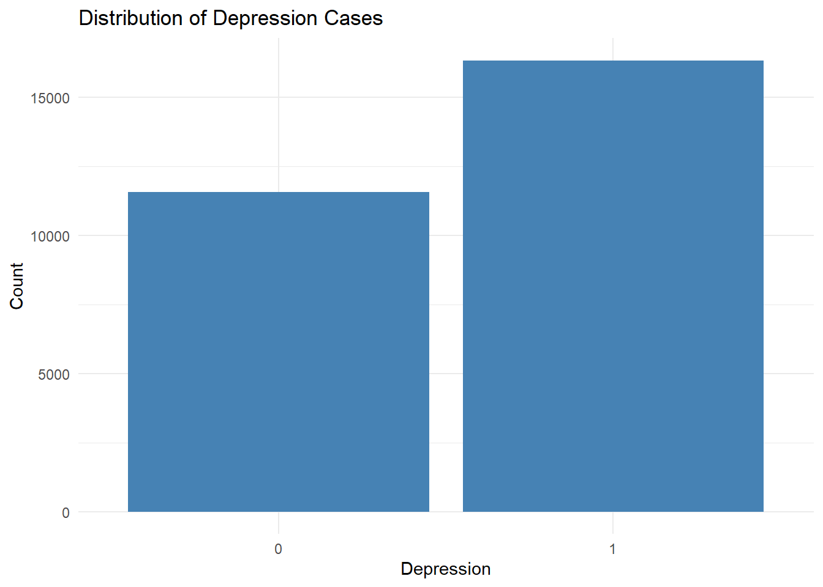
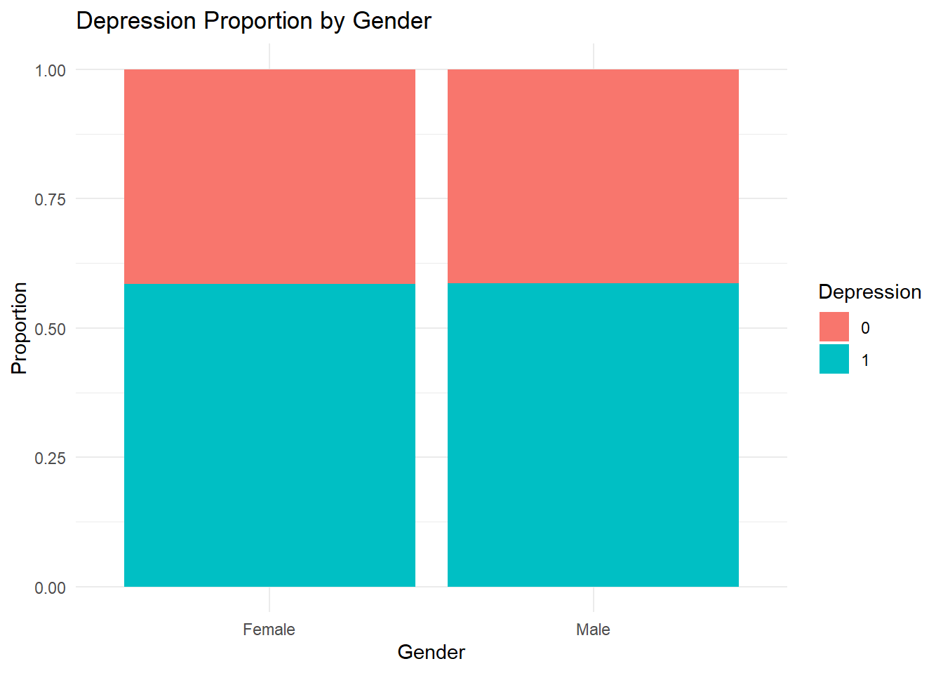
EDA
0: Individuals who did not report depression.
1: Individuals who did report depression.
Findings:
There are more individuals in the '1' category
than in the '0' category.
This means a larger proportion of the reported
individuals having depression.
Depression proportion by gender:
Both female and male groups show nearly equal proportions
of individuals reporting depression.

Slide 5
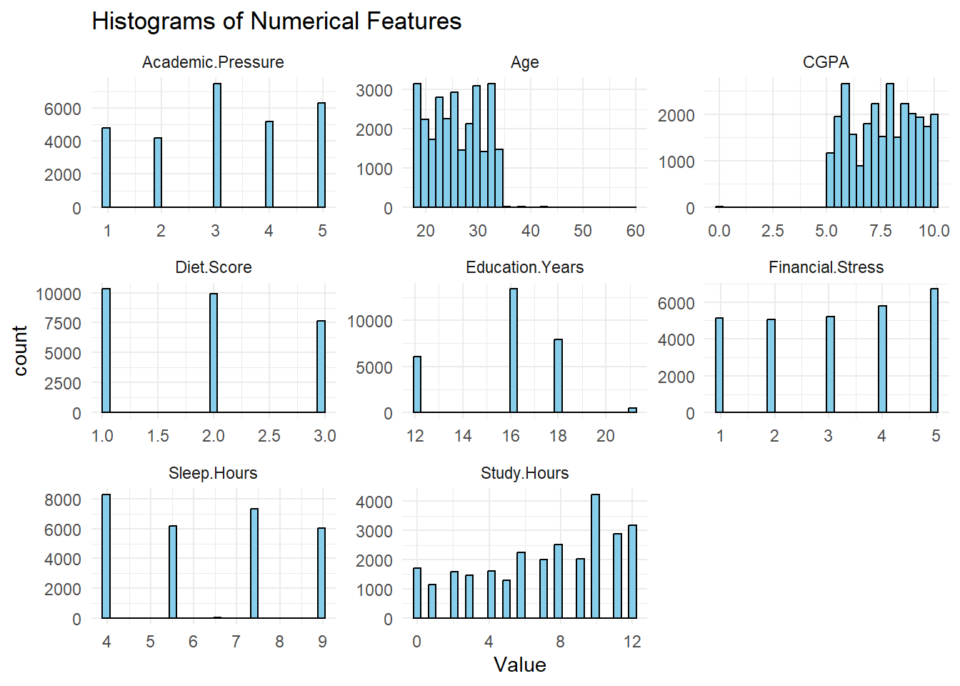
EDA
Academic Pressure: Fairly evenly distributed across the 1–5 scale.
Age: Most participants are aged 20–30, with very few outliers above 40.
CGPA: Concentrated between 5.0 and 9.5, suggesting decent academic performance.
Diet Score: Mostly scores of 1 to 3, indicating a limited range of responses.
Education Years: Peaks at 16 and 18 years, typical of college-educated individuals.
Financial Stress: Evenly spread across all levels (1–5), showing varying stress experiences.
Sleep Hours: Peaks at 4, 7, and 8 hours, showing varied sleep habits.
Study Hours: Peaks at 8 to 12 hours, indicating high academic engagement.

Slide 6
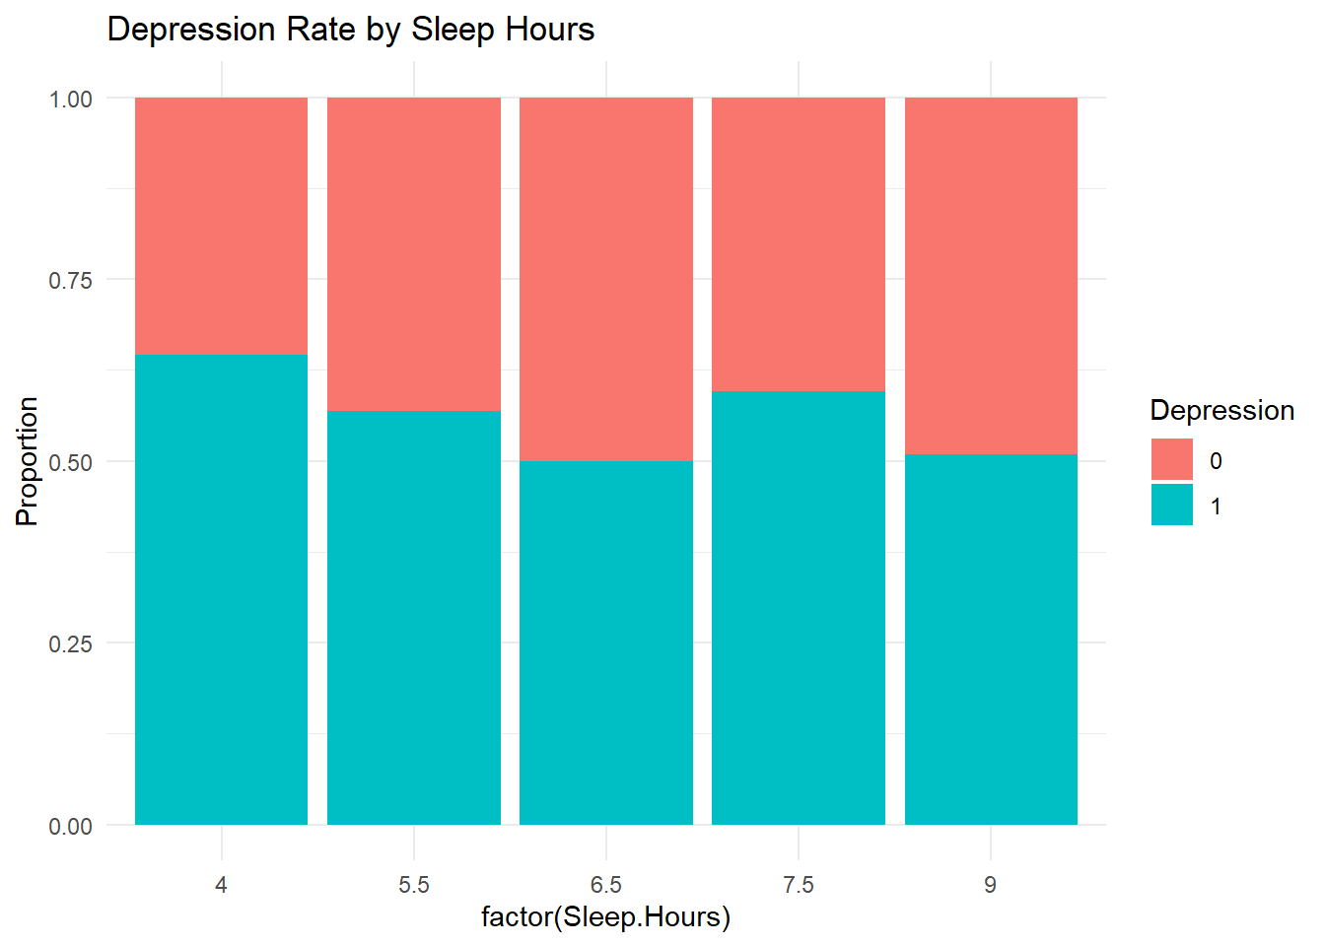
EDA
Cyan (1): Proportion of individuals with depression.
Red (0): Proportion without depression.
Insights:
People who sleep around 6.5–7.5 hours tend to have lower rates of depression (shorter cyan bars).
Those who sleep less (e.g 4 hours) or more (e.g 9 hours) show higher depression proportions.
This suggests a U-shaped relationship: both insufficient and excessive sleep may be associated with higher depression risk.

Slide 7
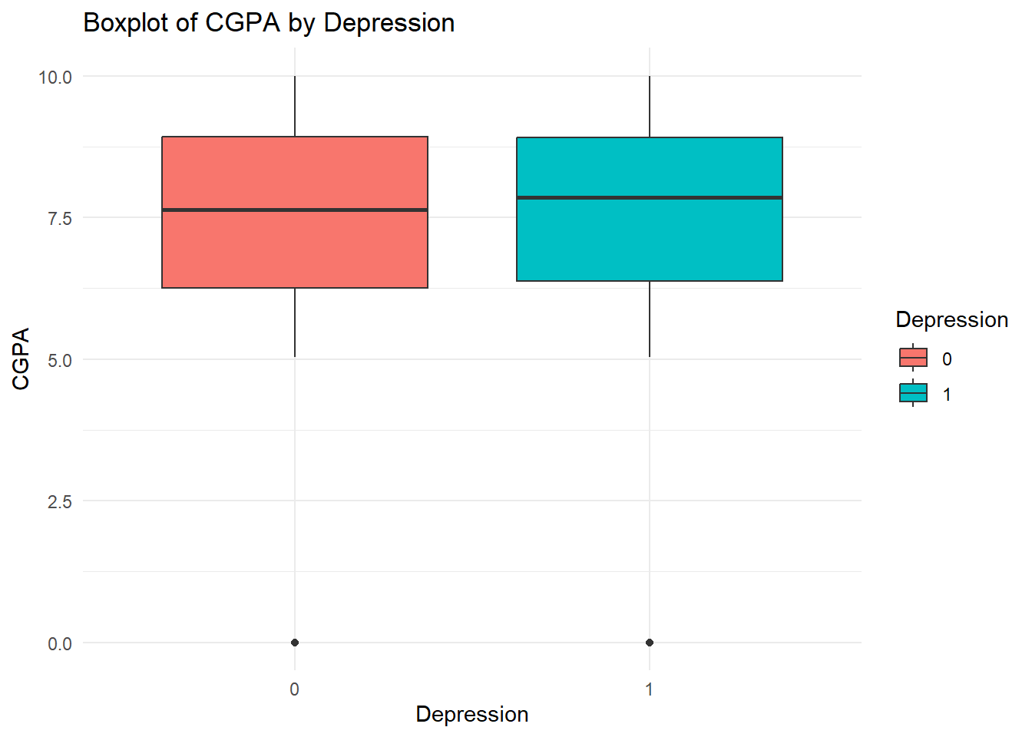
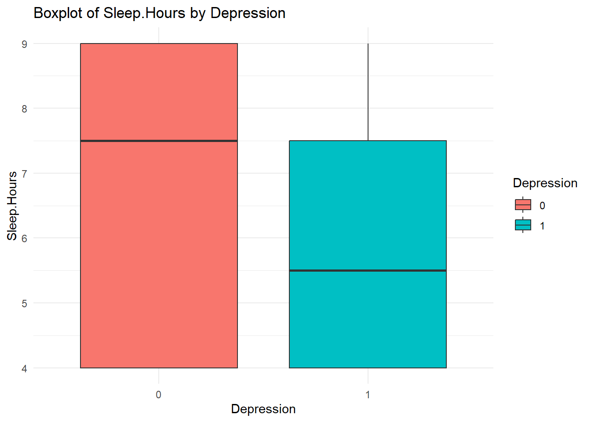
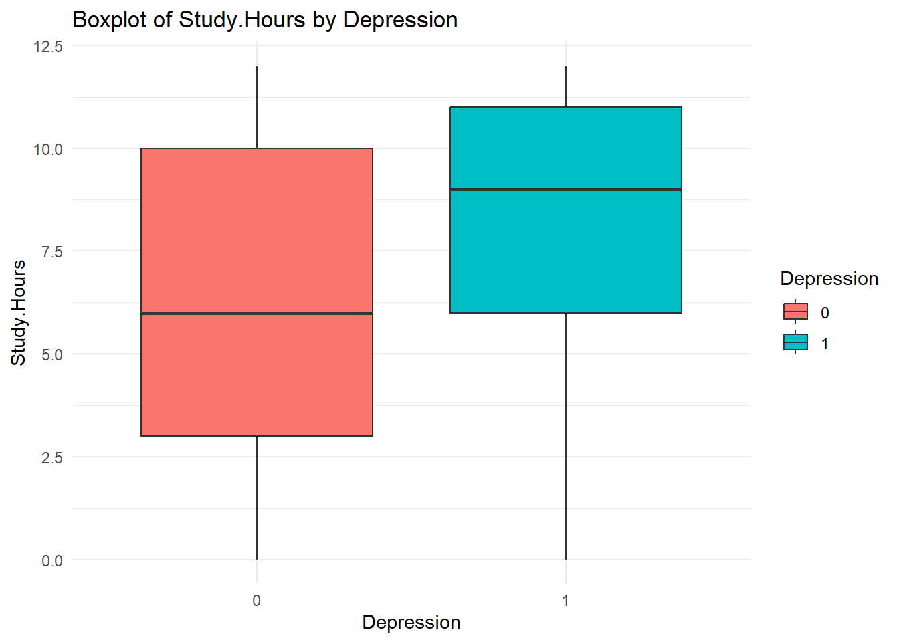
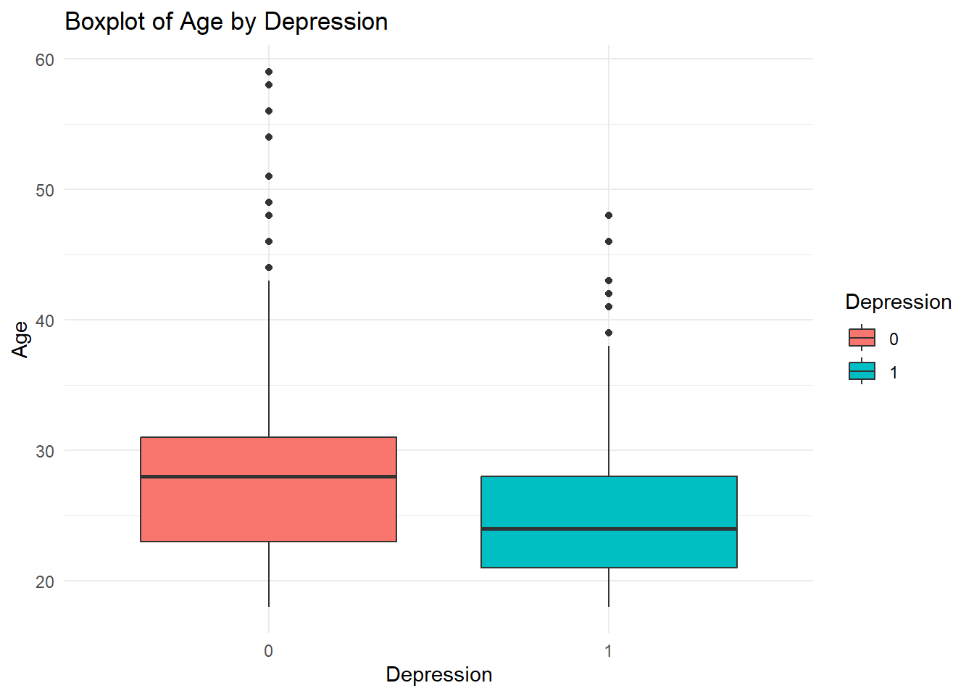
EDA
Cyan (1):

Slide 8
1. CGPA by Depression
Both groups (Depressed = 1 and Not Depressed = 0) have similar CGPA distributions.
The median CGPA is slightly higher for those with depression.
This suggests CGPA may not be a strong predictor of depression.
2. Sleep Hours by Depression
Individuals without depression tend to sleep more (median ≈ 7.5–8 hrs).
Depressed individuals sleep less on average (median ≈ 5.5 hrs).
Indicates shorter sleep durations are associated with higher depression risk.
3. Study Hours by Depression
Those with depression have a higher median of study hours (≈ 8–9 hrs) than non-depressed individuals (≈ 6 hrs).
Suggests that excessive studying may correlate with increased depression, possibly due to stress or burnout.
4. Age by Depression
Median age is younger for depressed individuals (≈ 25) compared to non-depressed (≈ 28–30).
Younger participants appear more vulnerable to depression in this dataset.

Slide 9
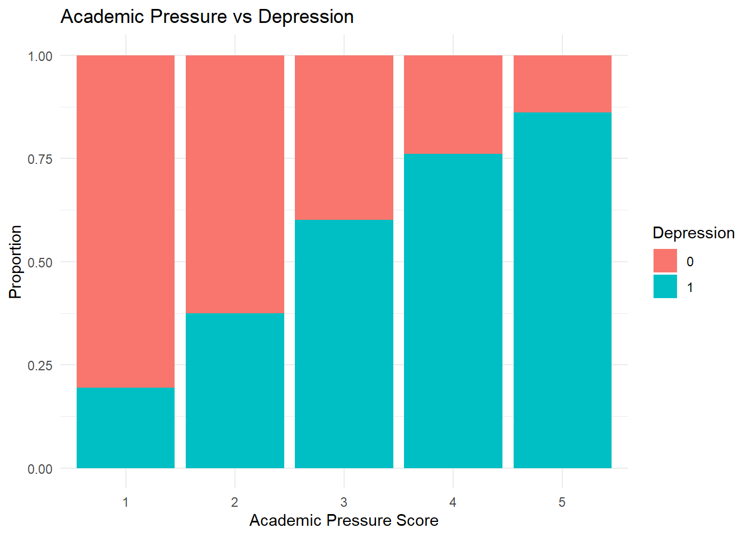
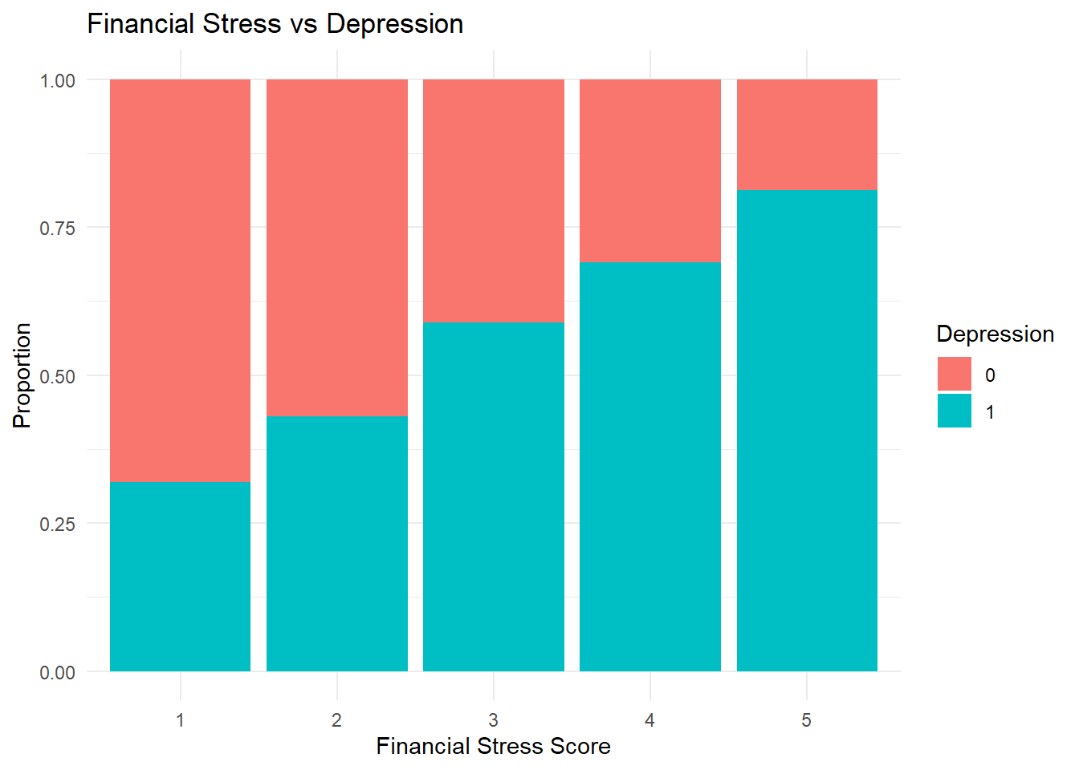
Academic Pressure: Depression rates increase sharply with higher academic pressure. → Highest at score 5.
Financial Stress: Depression also rises steadily with increasing financial stress. → Peaks at score 5.
Insights:
Both academic and financial stress are positively correlated with depression higher stress levels mean higher likelihood of depression.

Slide 10
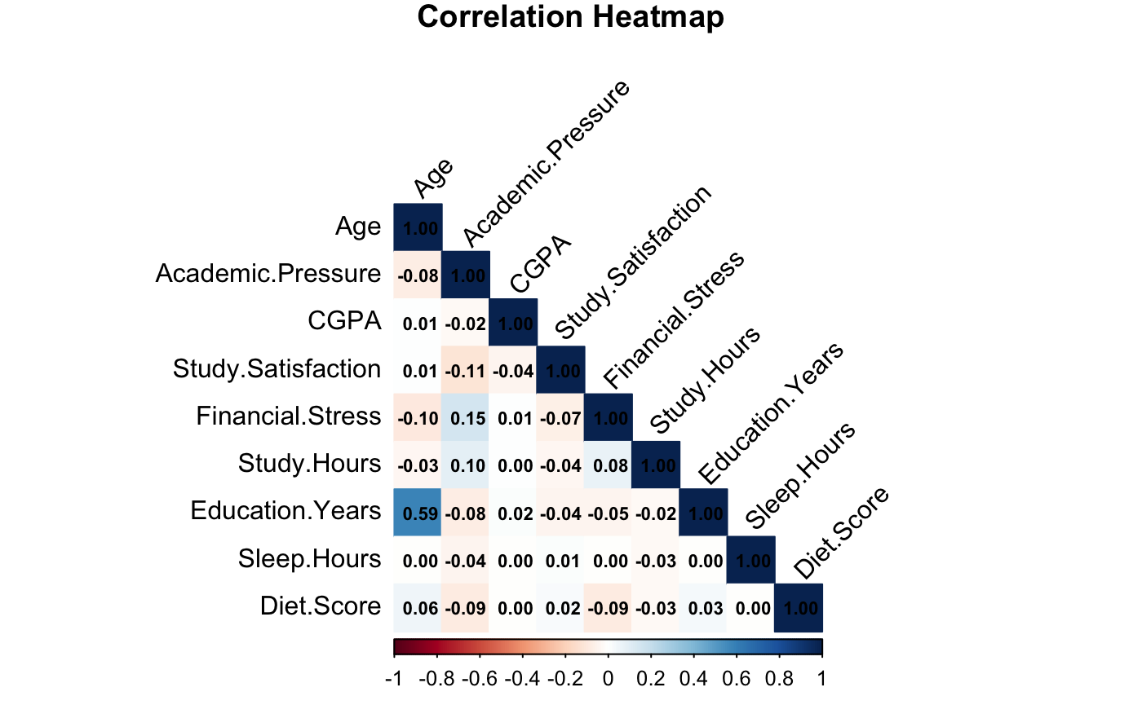
Correlation Heatmap

Slide 11



INFERENTIAL STATISTICS
Personal stats
Stress & Satisfaction
Lifestyle Factors
H₀: β = 0 (the independent variable has no significant effect on depression)
H₁: β ≠ 0 (the independent variable has a significant effect on depression)

Slide 12
Personal Stats
Variable | Type | Test | Results
Age | Numeric | t-test | Depressed students are significantly younger on average (p < 2.2e-16).
CGPA | Numeric | t-test | Depressed students had a slight statistically significant (p = 0.00022) higher CGPA on average.
Family History of Mental Illness | Factor | Chi-square test | X² = 79.434, p < 2.2e-16: A significant association between family history and depression.
Suicidal Thoughts | Factor | Chi-square test | X² = 8323.9, p < 2.2e-16: A strong association between suicidal thoughts and depression.
Notes:
RAYE

Slide 13
Stress & Satisfaction
Variable | Type | Test | Results
Financial Stress | Integer | Wilcoxon* | Depressed students report more financial stress (Wilcoxon p < 2.2e-16).
Academic Pressure | Integer | Wilcoxon | Depression is significantly associated with higher levels of academic pressure (Wilcoxon p < 2.2e-16).
Study Satisfaction | Integer | Wilcoxon | Students with depression report significantly lower satisfaction with their studies (Wilcoxon p < 2.2e-16).
*Initially considered a two-sample t-test, but variables are ordinal even though they are integers. We also cannot justify/assume normality for these variables
Notes:
RAYE

Slide 14
Lifestyle Factors
Variable | Type | Test | Results
Sleep Hours | Numeric | t-test | Students with depression sleep significantly less (p < 2.2e-16).
Diet Score | Numeric | t-test | Students with depression report significantly poorer diets (mean score 1.77 vs 2.10), (p < 2.2e-16).
Study Hours | Numeric | t-test | Depressed students study much more (p < 2.2e-16).
Notes:
RAYE

Slide 15
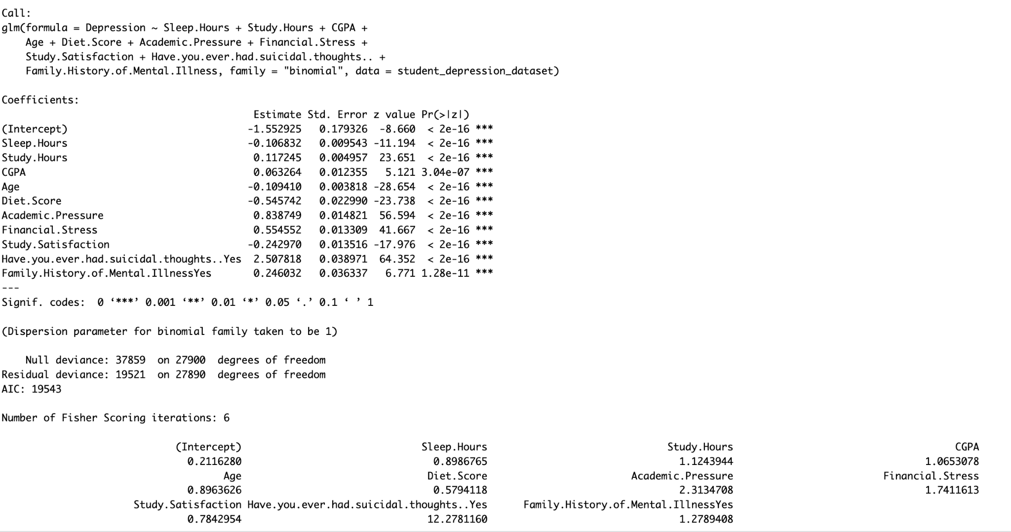
Suicidal Thoughts
Academic Pressure
Financial Stress
Diet Score
Study Hours
Age
Sleep Hours
Study Satisfaction
Family History of Mental Illness
CGPA

Slide 16
Machine Learning
Model Building
Logistic Regression
Random Forest Classifier
Decision Tree Classifier
KNN Classifier

Slide 17
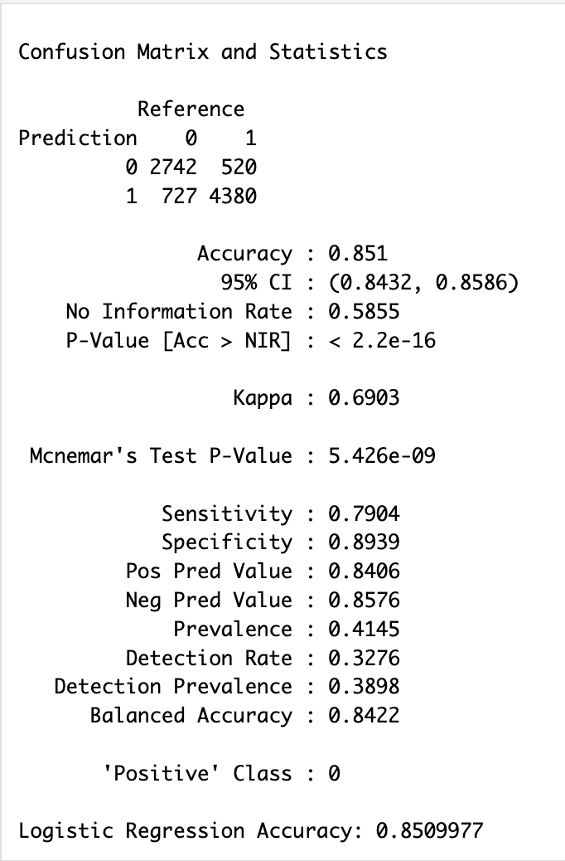
Logistic Regression
Output:
1) The confusion matrix shows strong classification performance for both depressed and non-depressed students.
2) The model achieved an accuracy of 85.10%, the highest among all models tested.
3) A Kappa score of 0.6903 indicates substantial agreement beyond chance, reflecting consistent prediction quality.
4) These results confirm that logistic regression is both effective and reliable for depression prediction in students.

Slide 18
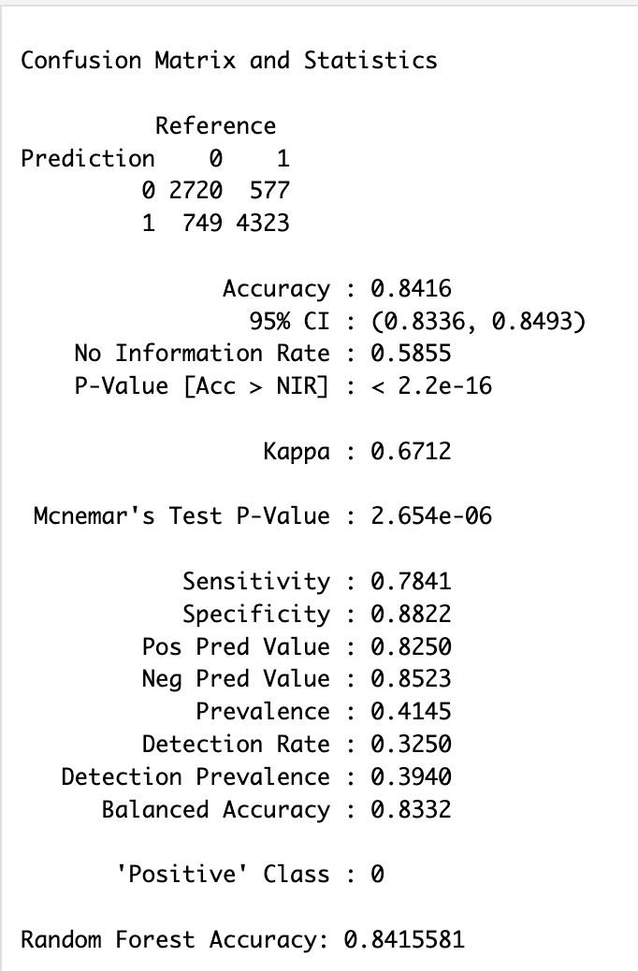
Random Forest Classifier
Output:
1) The confusion matrix indicates that the model performed well across both classes, correctly predicting the majority of depressed and non-depressed students.
2) The accuracy of 84.16% is very close to that of logistic regression, making Random Forest a strong contender.
3) With a Kappa score of 0.6712, the model shows substantial agreement beyond chance.
4) A balanced accuracy of 83.32% reflects the model's ability to perform consistently across both positive and negative classes.

Slide 19
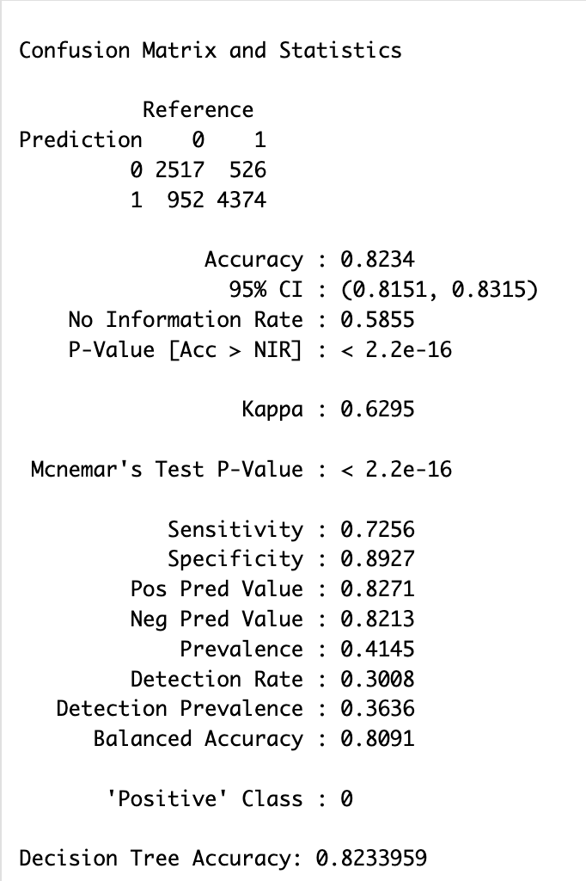
Decision Tree Classifier
Output:
1) The confusion matrix shows that the Decision Tree model made mostly correct predictions, though with slightly lower sensitivity compared to other models.
2) It achieved an accuracy of 82.34%, which is solid but slightly behind Logistic Regression and Random Forest.
3) The Kappa score of 0.6295 indicates a good level of agreement beyond chance.
4) With a balanced accuracy of 80.91%, the model still performed fairly well in identifying both depressed and non-depressed students.

Slide 20
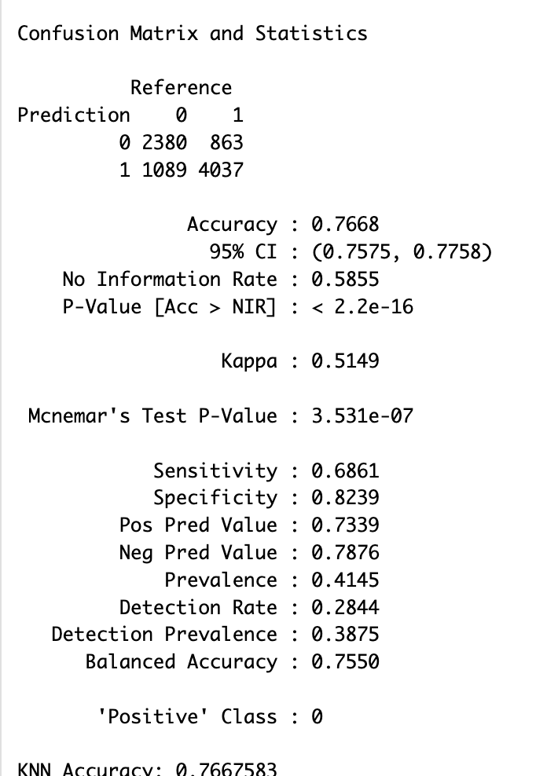
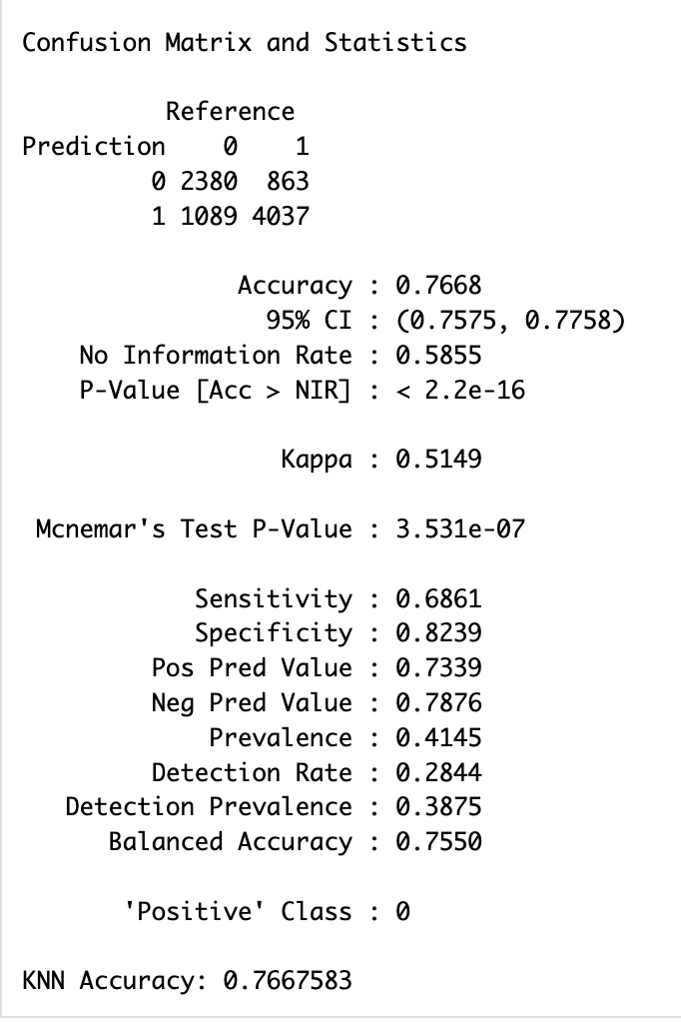
KNN Classifier
Output:
1) The confusion matrix shows that KNN correctly predicted a majority of cases, though it had lower sensitivity compared to other models.
2) The model achieved an accuracy of 76.68%, which is the lowest among the four, indicating limited performance.
3) A Kappa score of 0.5149 reflects moderate agreement beyond chance, showing that predictions are somewhat reliable.
4) With a balanced accuracy of 75.50%, KNN performed reasonably well but was clearly outperformed by the other models in this analysis.

Slide 21
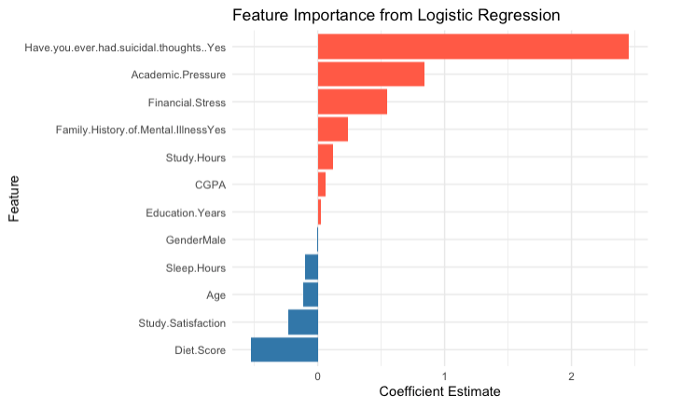
Feature Importance

Slide 22
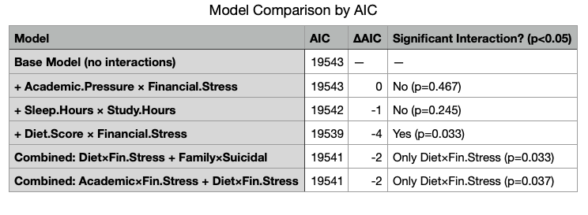
Models with Interaction Terms
Financial stress exacerbates the negative impact of poor diet on depression risk

Slide 23
Conclusion

